Slide 1
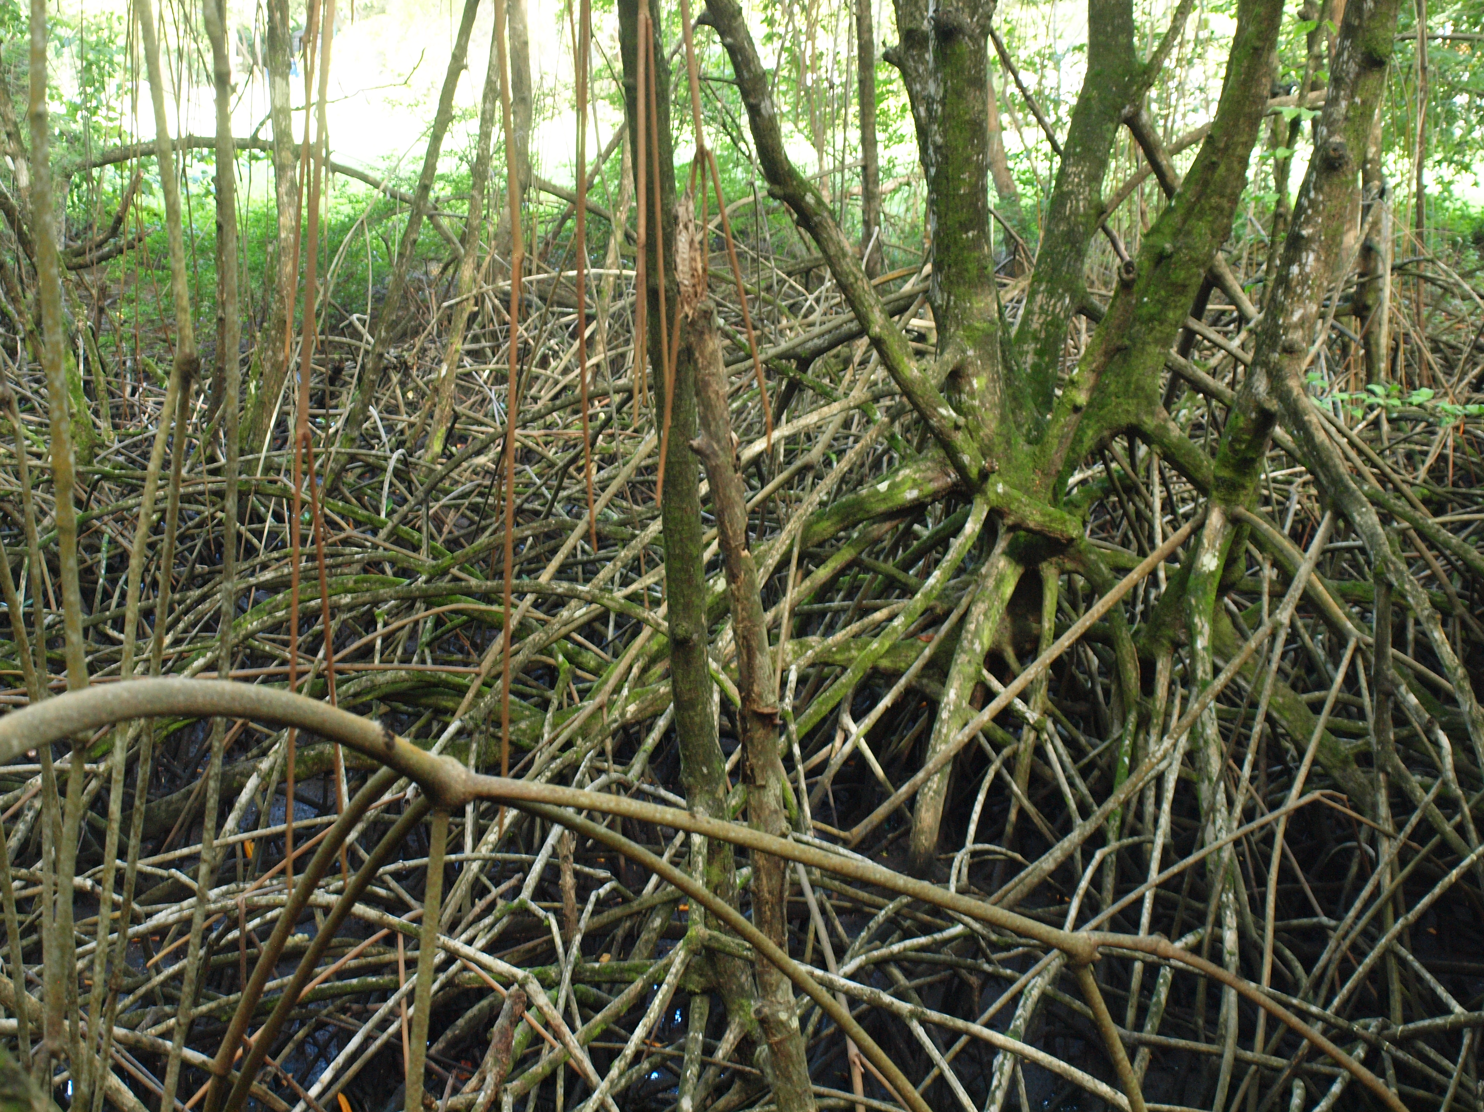
Towards A Global Mangrove Monitoring Service
Hans-Peter Plag, Mitigation and Adaptation Research Institute,
Old Dominion University, Norfolk, VA, USA
1

Slide 2
C2 Sustained Ecosystems and Food Security
Leads: Canada (POGO, tplatt@dal.ca), CEOS (NOAA) and IEEE
Priority Actions
• Assure sustainability and global coverage for both ChloroGIN (International network to assess the state of marine, coastal and inland-water ecosystems) and GACS (Global Alliance of Continuous Plankton Recorder Surveys). The longer-term aim would be to make both fully operational
• Advance the development of global monitoring services for mangroves, coral reefs, and estuaries: Assess user needs and observational requirements; support related observing networks (e.g. Global Coral Reef Monitoring Network); implement demonstrators for monitoring services; and assess status and trends based on these demonstrators
• Design and implement a suite of ecological indicators with a view to detecting changes in ocean ecosystems (e.g. due to climate change, overfishing)
• Develop applications of rapidly-evolving satellite technology to fish harvesting and fish health assessment. Accelerate the integration of Earth observation and information into fishery research and ecosystem-based fishery management on a global scale, through international coordination and outreach. Support the SAFARI project (Societal Applications in Fisheries and Aquaculture using Remotely-Sensed Imagery)

Slide 3
Many agencies have information on mangroves and monitoring of mangroves

Slide 4
Many agencies have information on mangroves and monitoring of mangroves

Slide 5
There are many publication addressing various aspects of mangrove monitoring based on remote sensing

Slide 8
Prepare an assessment report on needs, status, and options for mangrove monitoring
Step 1: Establish a small GEO expert team on mangrove monitoring
Step 1a: Contact Blue Carbon
Step 2: Prepare Report: Review of current status of activities towards an operational RS mangrove monitoring service:
- who are the groups involved?
- are there already relevant communities of practice?
- are there regional, national RS-based monitoring services?
- are there groups already in GEO or linked to GEO POs?
- which GEO Member Countries are covered/involved?
- what are the information and knowledge needs and who are the users?
- what are the requirements (latency, repetitions, spatial and temporal
resolution,… )?
- status of methodology and technology
- what are research, technology, and capacity issues?
- what could GEO add?
- outline a road map
Step 3: Make recommendations how to proceed to Blue Planet/GEO …

